Slide 1
Computer Networks & IOT (18B11CS311)
Even Semester_2021
1
Notes:
1

Slide 2
Transport Layer
2

Slide 3
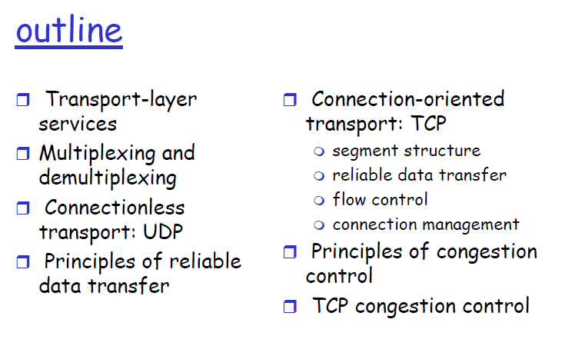
3
Notes:
3

Slide 4
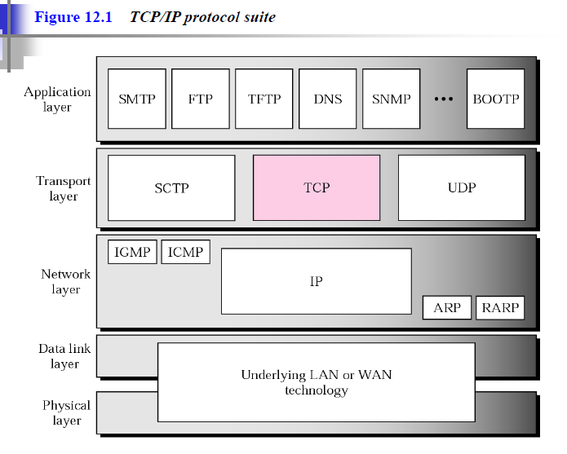
4

Slide 5
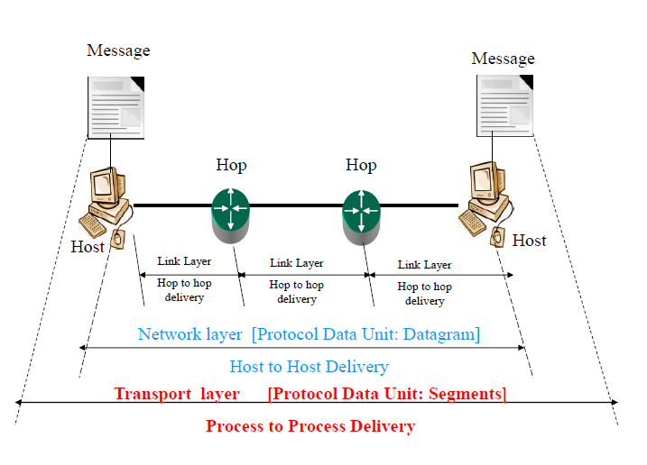
5

Slide 6
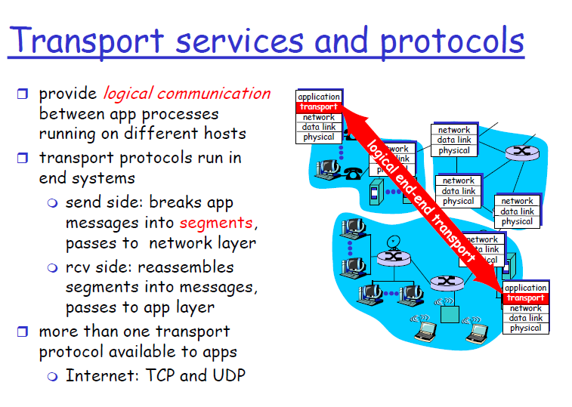
6

Slide 7
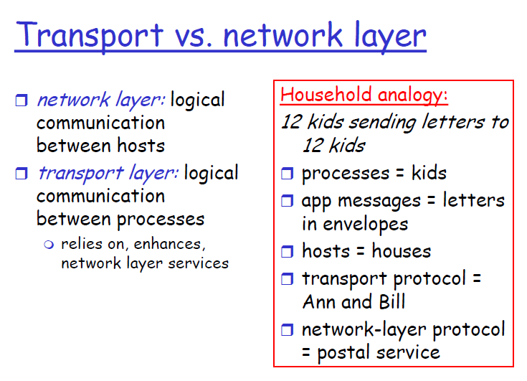
7

Slide 8
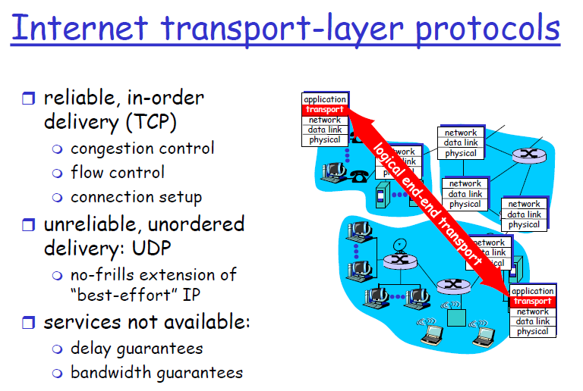
8

Slide 9
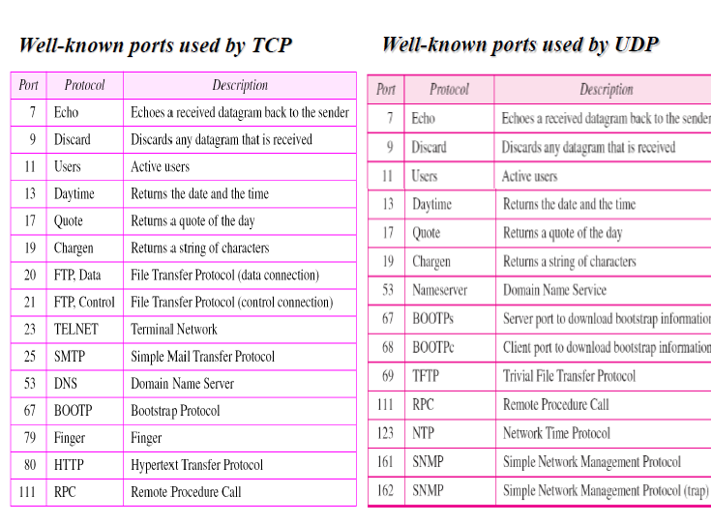
9

Slide 10
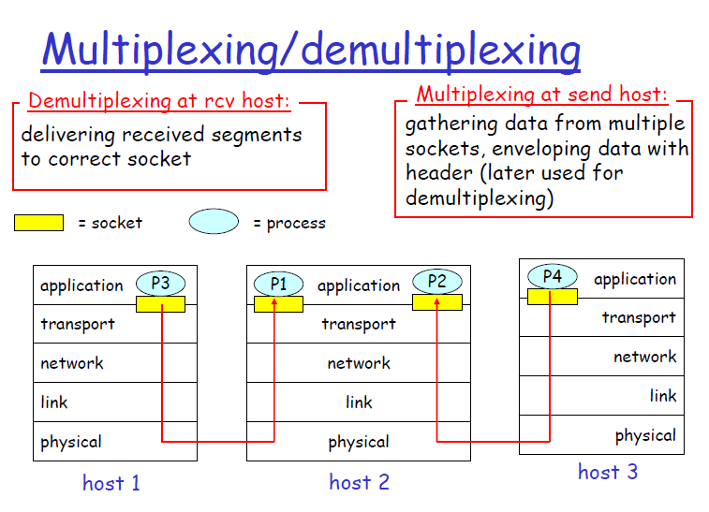
10

Slide 11
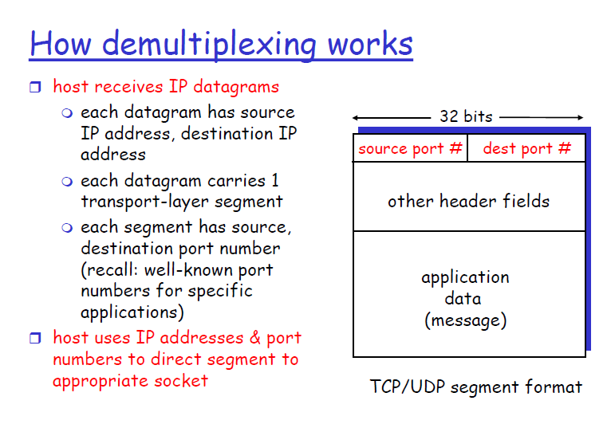
11

Slide 12
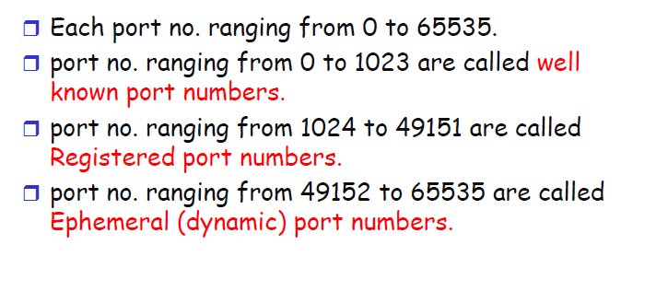
12

Slide 13
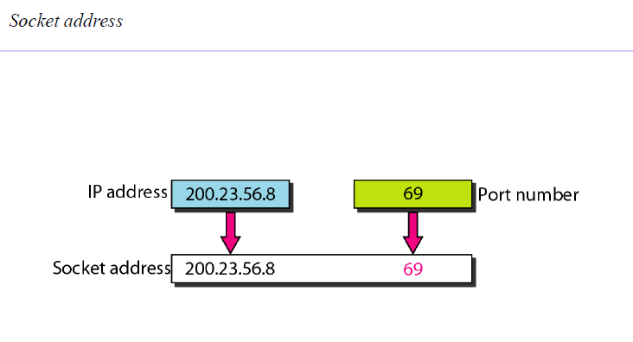
13

Slide 14
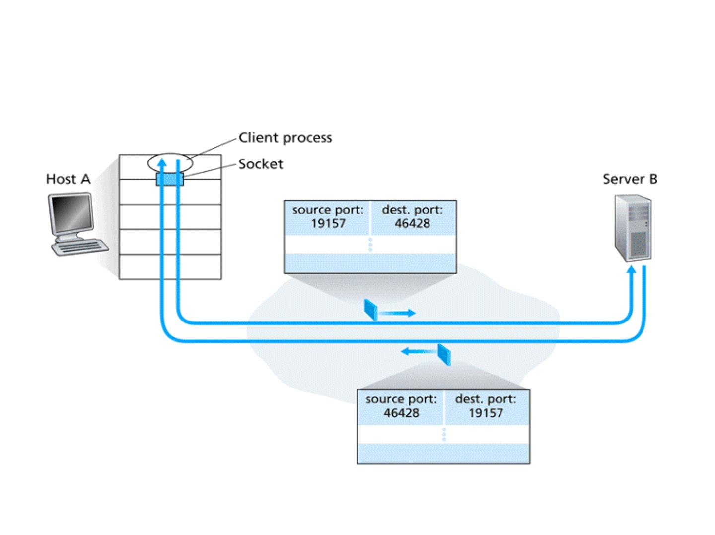
Inversion of source and destination
port numbers

Slide 15
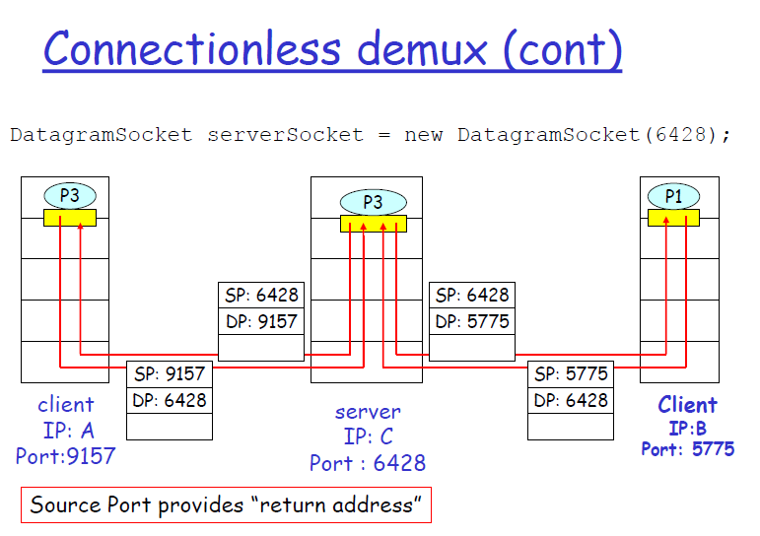
15

Slide 16
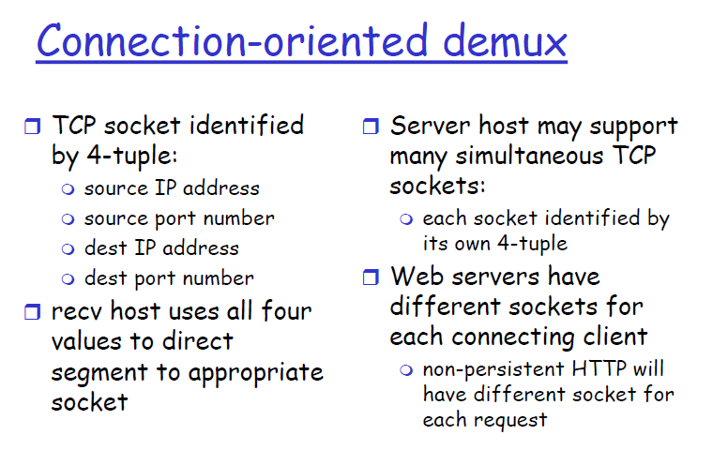
16

Slide 17
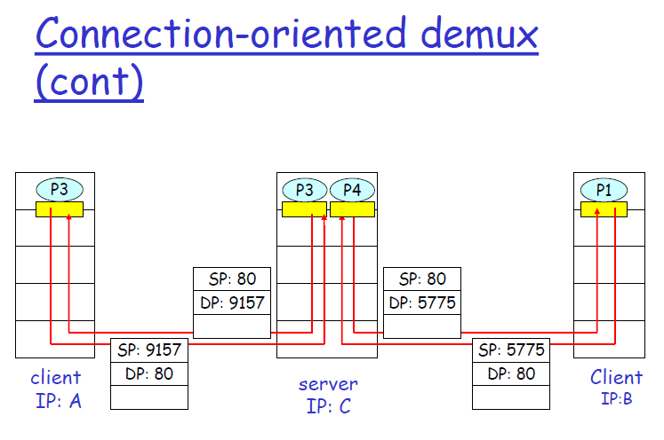
17
Notes:
17

Slide 18
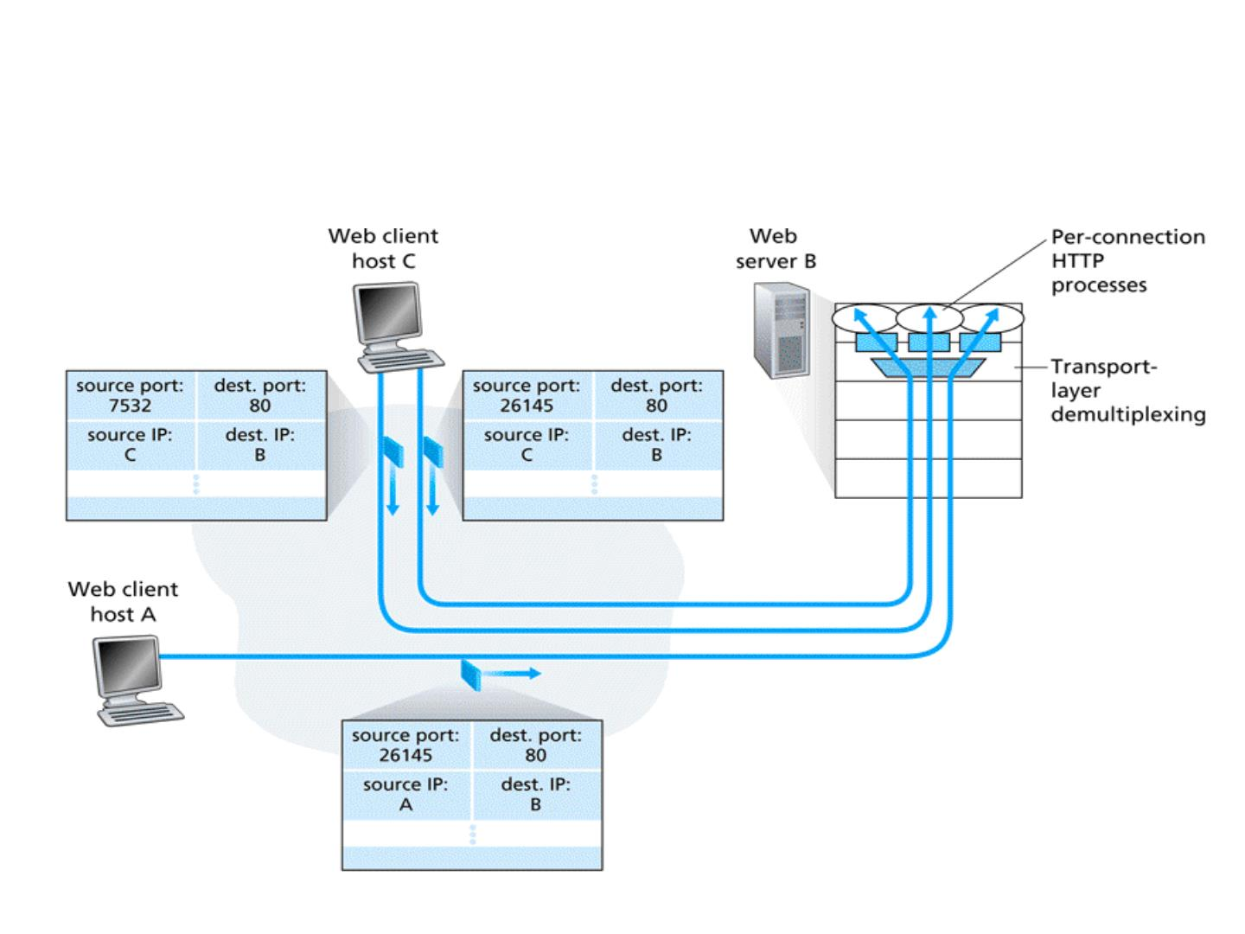
2 clients using the same port (80) –
web server application

Slide 19

UDP
User Datagram Protocol

Slide 20
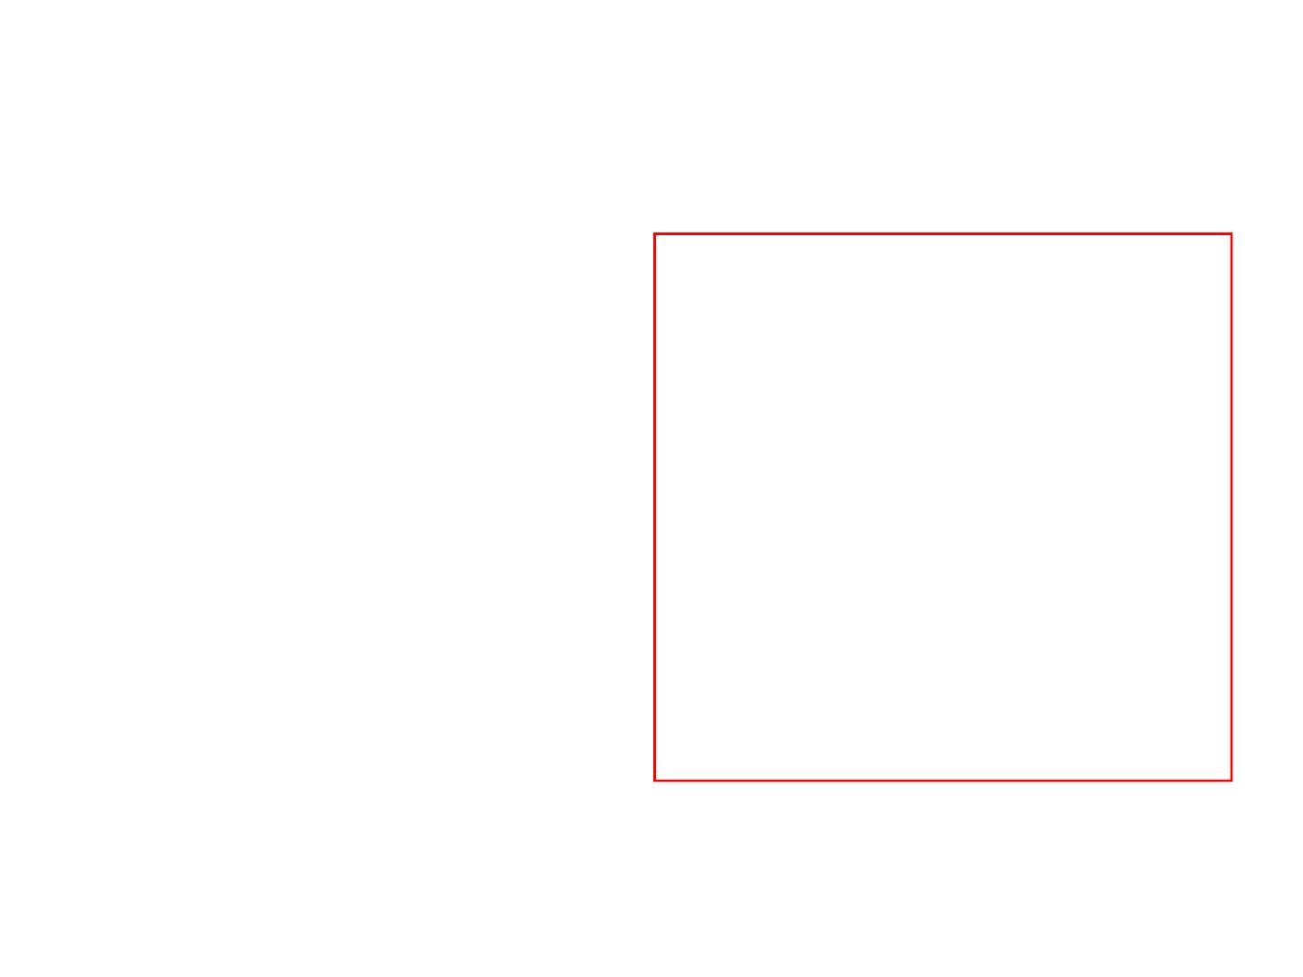
UDP: User Datagram Protocol
❒ “best effort” service, UDP
segments may be:
Why is there a UDP?
🔾 lost
no connection
establishment (which can
add delay)
❒
🔾 delivered out of order
to app
❒ connectionless:
❒
simple: no connection state
🔾 no handshaking between
at sender, receiver
UDP sender, receiver
❒ small segment header
🔾 each UDP segment
handled independently
of others
❒
no congestion control: UDP
can blast away as fast as
desired

Slide 21
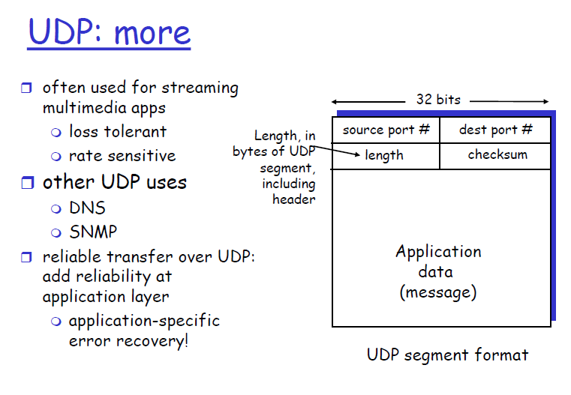
21

Slide 22
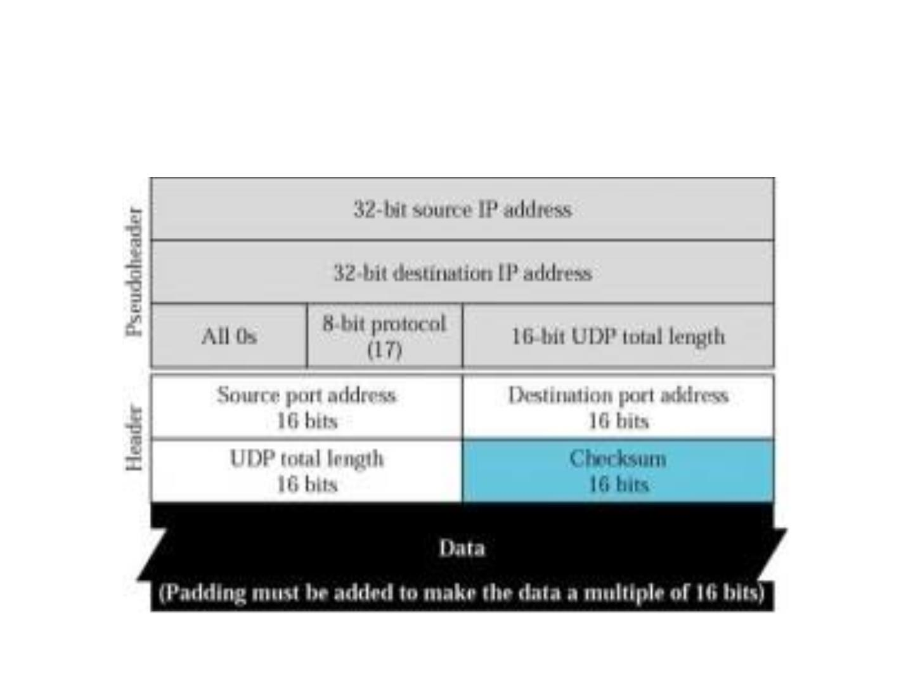
UDP segment format

Slide 23
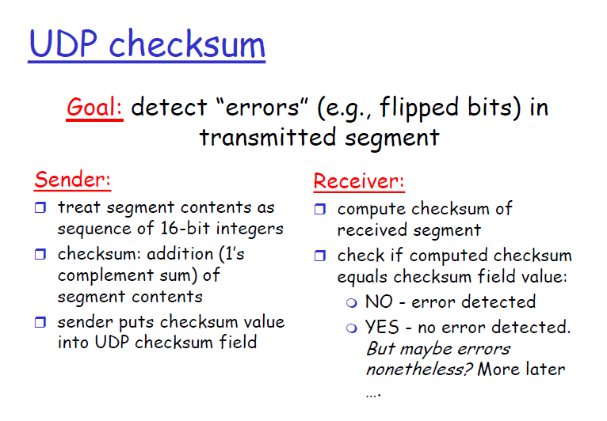
23

Slide 24
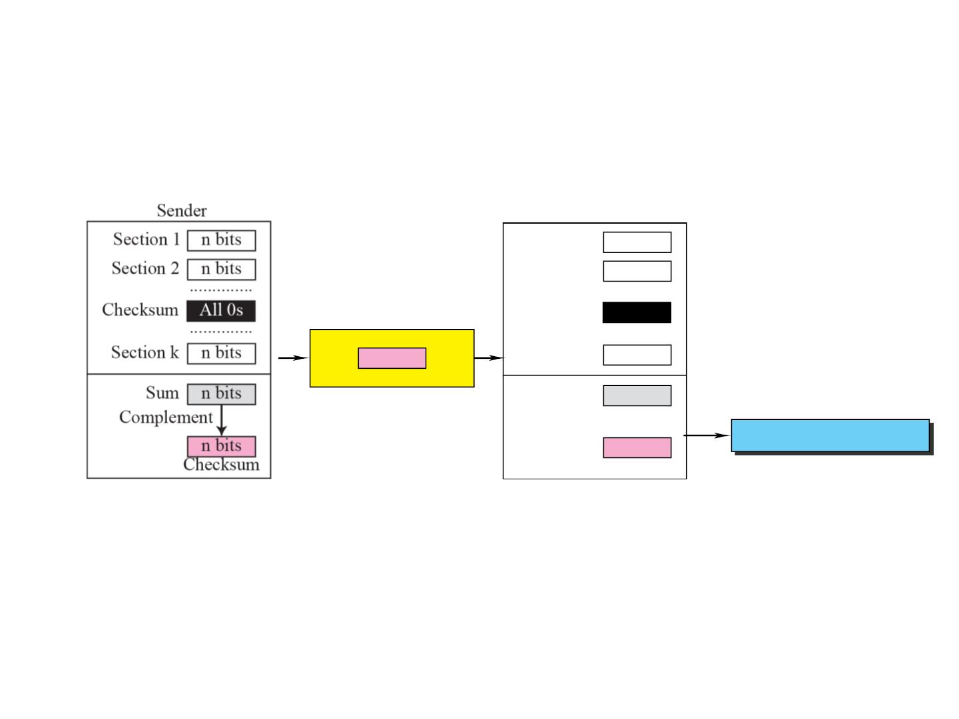
Checksum Concept
Receiver
Section 1 n bits
Section 2 n bits
..............
Checksum n bits
..............
n bits
Section k n bits
Checksum
Packet
Sum n bits
Complement
If the result is 0, keep;
otherwise, discard.
n bits
Result

Slide 25
How does the method of ones' complement work for UDP and TCP checksum Calculation?
Let's understand this by an example. Imagine we have a UDP segment or a TCP packet. The first thing that we do is to divide and slice it up to 16 bit pieces. Let's assume we have three 16 bit data as below.
1 0 0 1 1 0 1 0 0 1 0 1 0 1 1 0
0 0 0 0 1 0 1 1 1 0 0 0 1 1 1 0
0 0 0 0 1 1 0 1 1 1 0 0 1 1 0 0
If we add those three 16 bit data using binary addition. We get the below 16 bit data(Its simple binary addition).
1001101001010110 + 0000101110001110 + 0000110111001100 = 1011001110110000
Ones complement of our result 1011001110110000 is 0100110001001111(This is our checksum). So we need to basically send our data (which is the three binary 16 bit numbers) along with its checksum to a recieaver. The main thing to understand is, the reciever will get the data as well as the checksum we calculated.

Slide 26
The reciever will get the below things. 1 0 0 1 1 0 1 0 0 1 0 1 0 1 1 0 (data) 0 0 0 0 1 0 1 1 1 0 0 0 1 1 1 0 (data) 0 0 0 0 1 1 0 1 1 1 0 0 1 1 0 0 (data) 0 1 0 0 1 1 0 0 0 1 0 0 1 1 1 1 (Checksum) The reciever will simply add all the above 4 things. Data as well as checksum are added together. Let's try adding it. 1001101001010110 + 0000101110001110 + 0000110111001100 + 0100110001001111 = 1111111111111111
If the output of sum of 16 bit data and checksum is 1111111111111111. All fields will be 1s. Even if there is one 0, then that means errors were introduced in the data during transit.

Slide 27
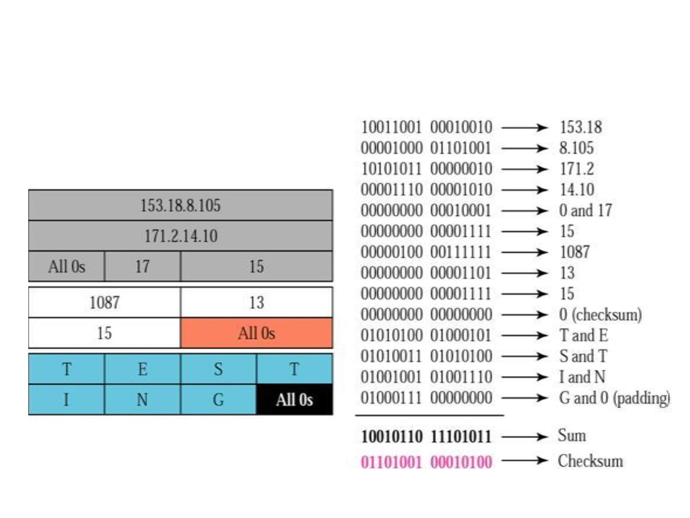
Checksum calculation at sender
side for 7 bytes of data

Slide 28
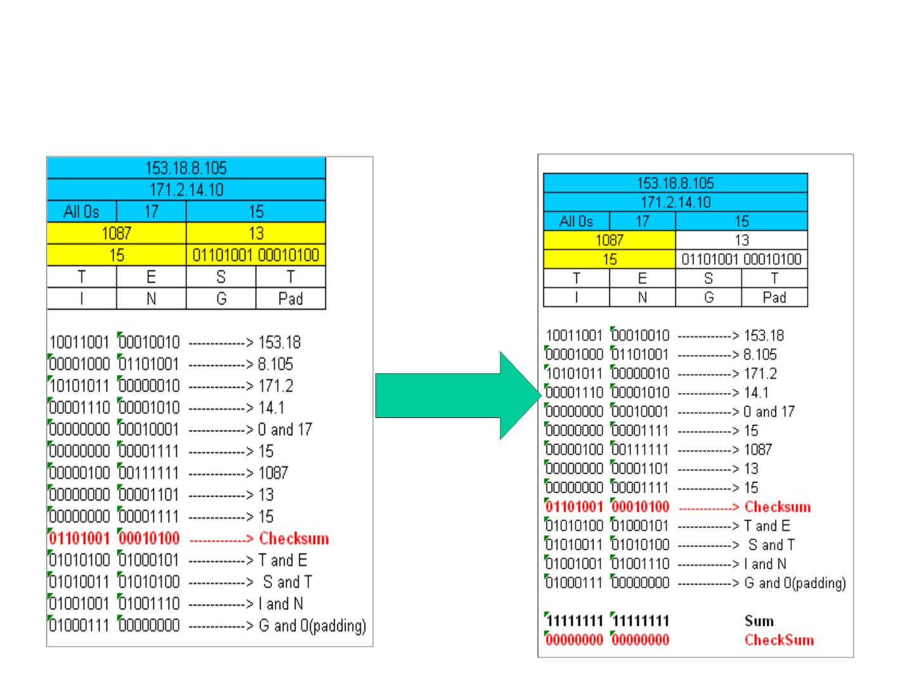
Checksum calculation at receiver side
Sender sends the UDP segment
Receiver receives the UDP segment
along with checksum filled
correctly

Slide 29
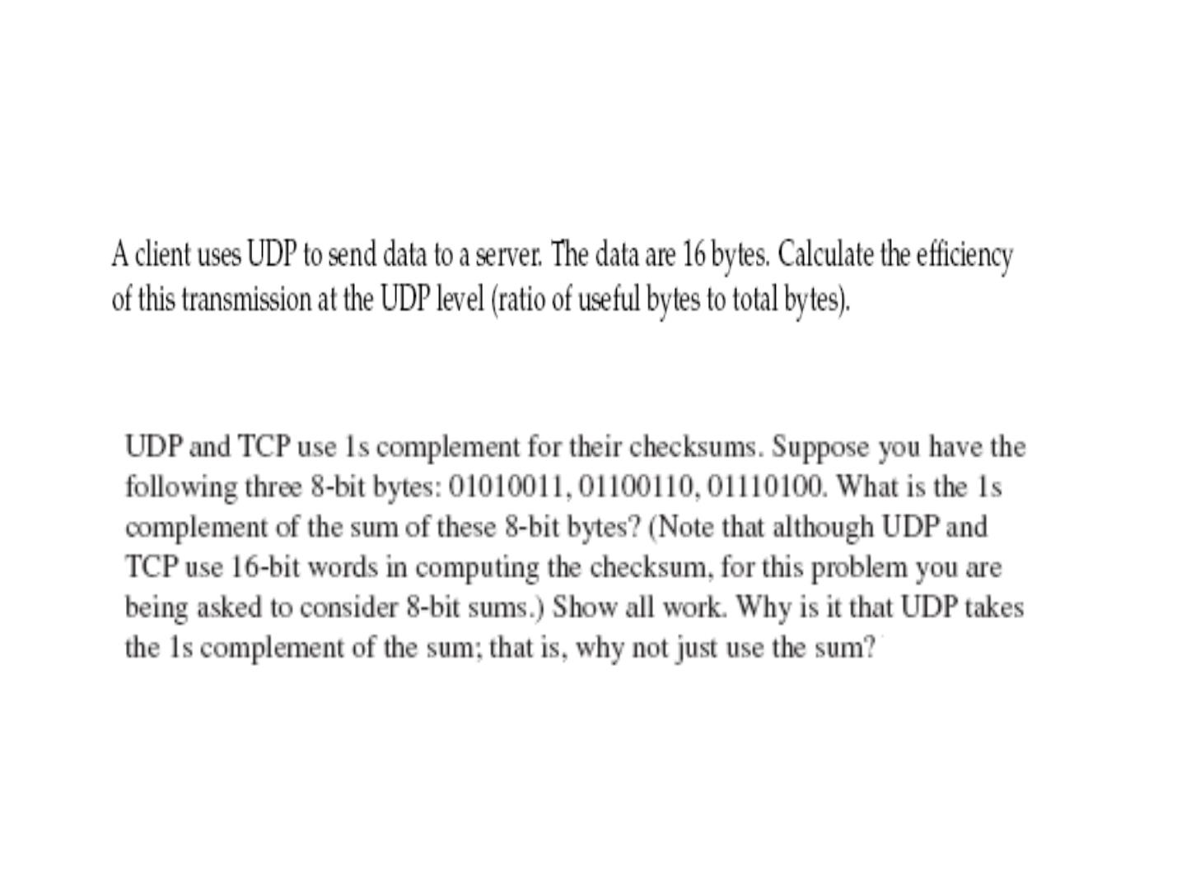
Questions..
Notes:
=16/(16+8)
29

Slide 30
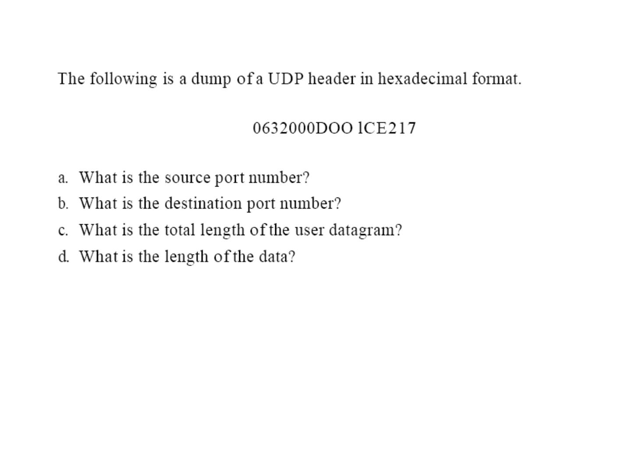

Slide 31
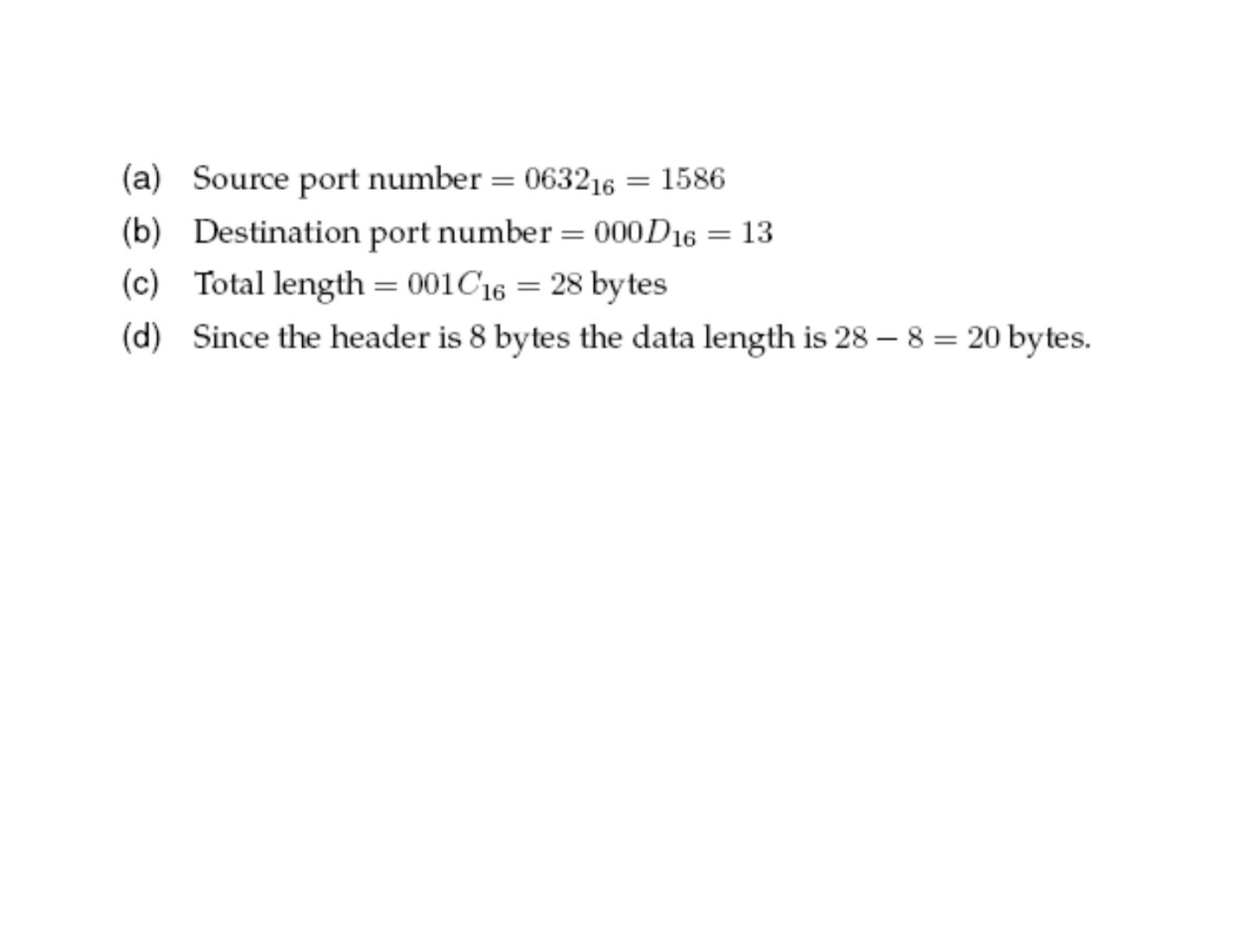

Slide 32
TCP

Slide 33
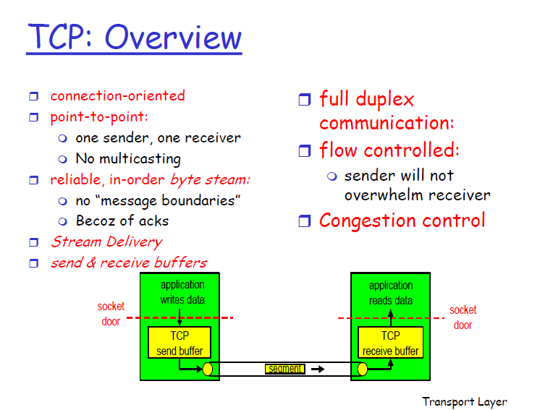
33

Slide 34
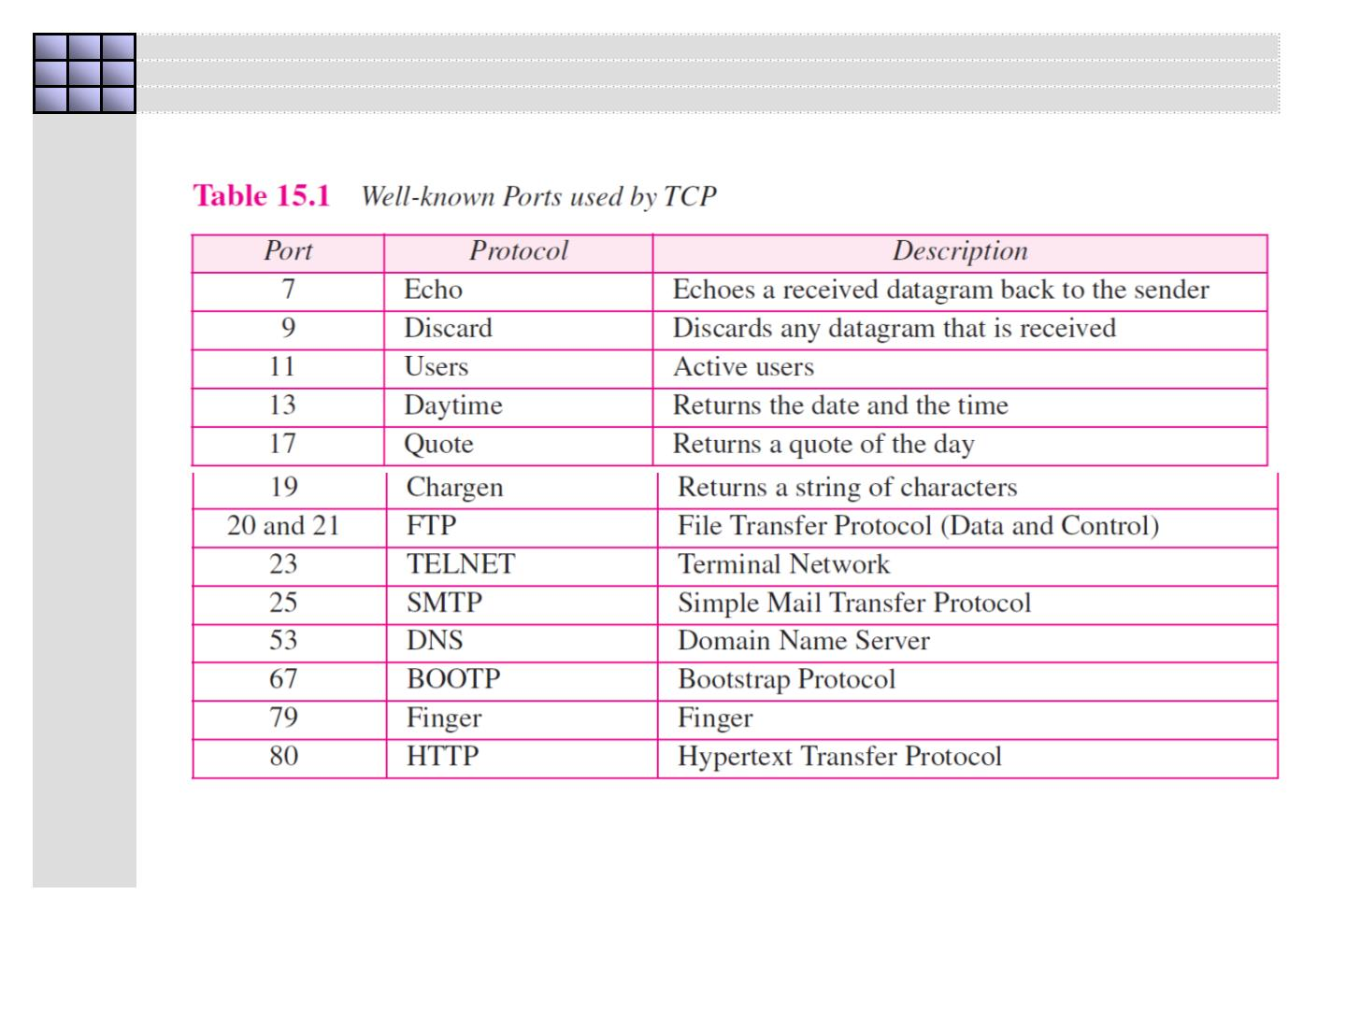

Slide 35
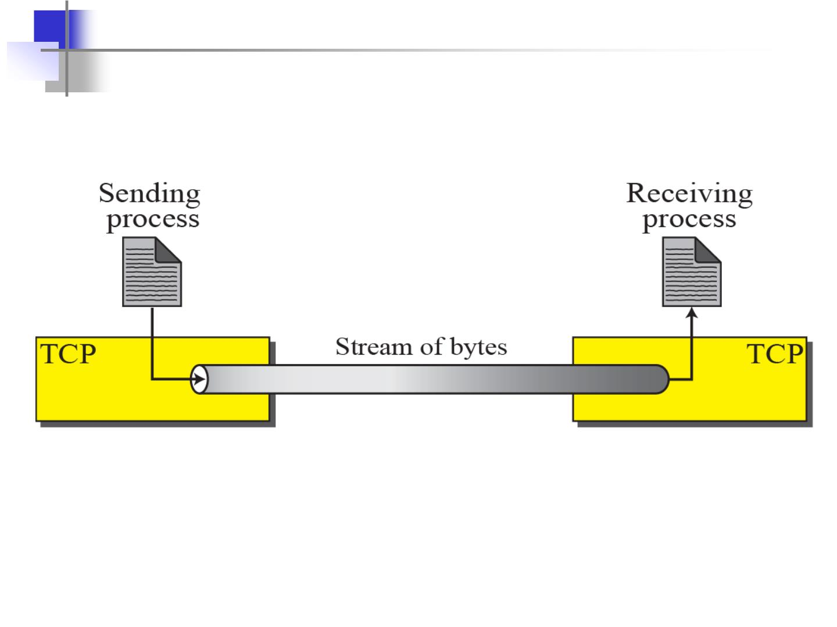
Stream delivery

Slide 36
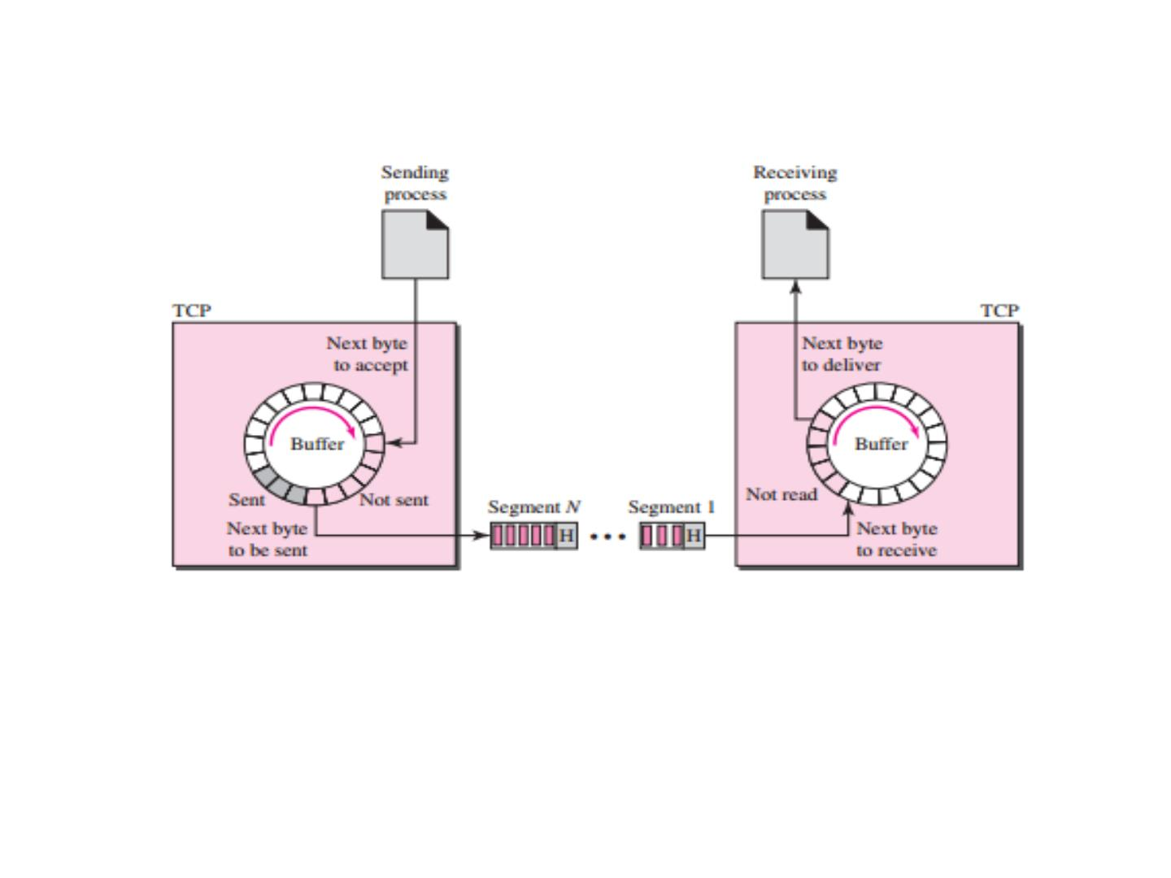

Slide 37
Numbering System:
❑ Byte Number
❑Sequence number
❑Acknowledgement number

Slide 38
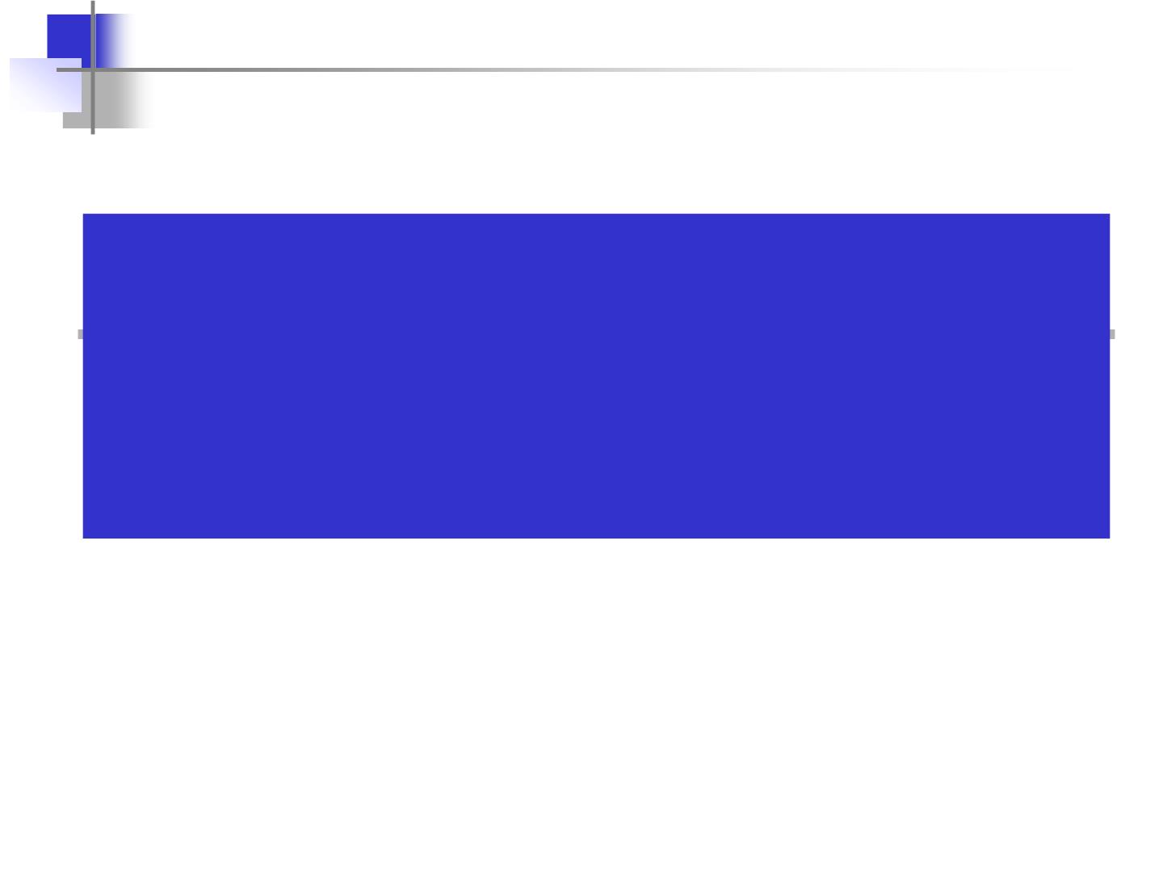
The bytes of data being transferred in
each connection are numbered by TCP.
The numbering starts with an
arbitrarily generated number.

Slide 39
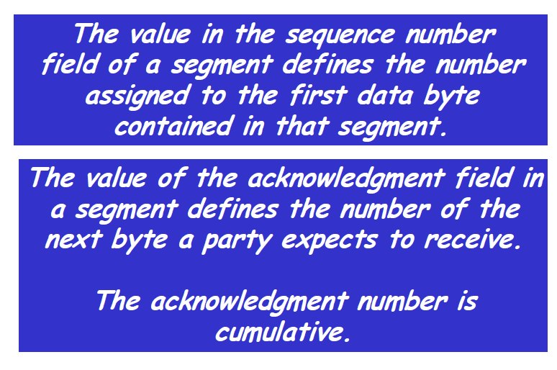
39

Slide 40
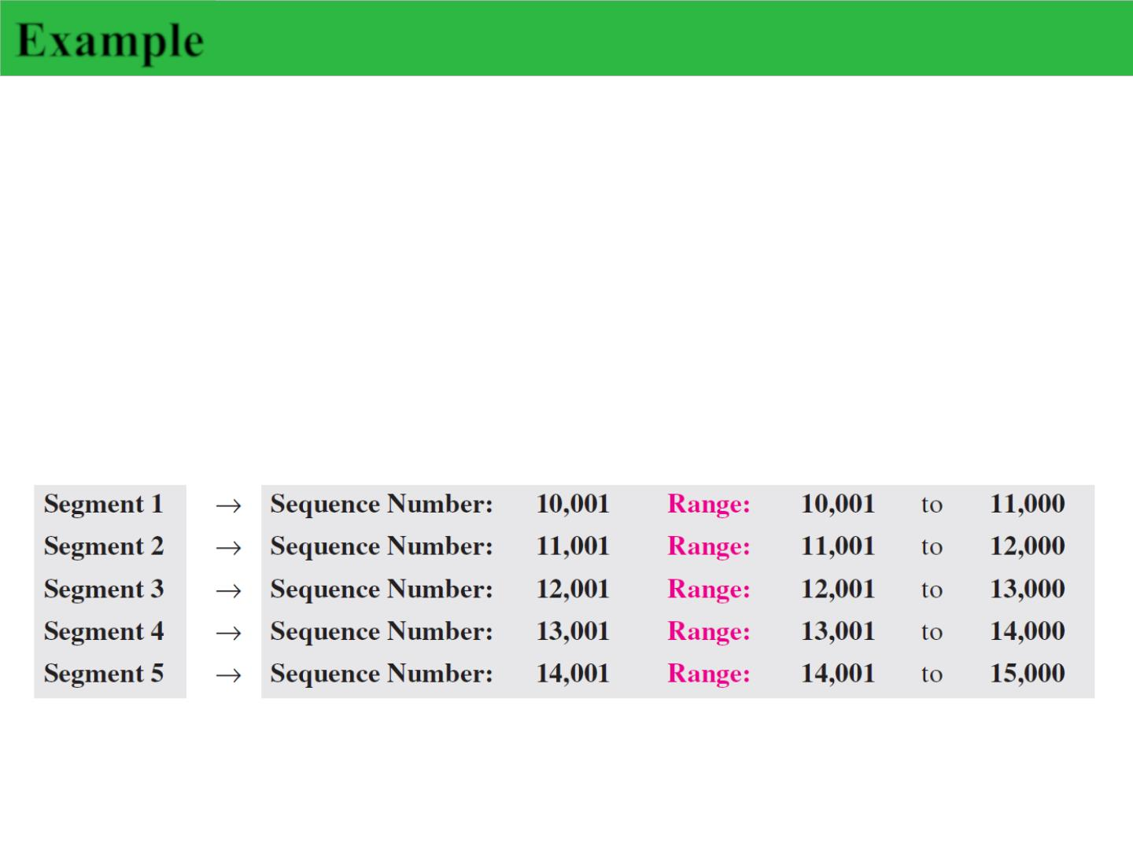
Example
Suppose a TCP connection is transferring a file of 5,000 bytes.
The first byte is numbered 10,001. What are the sequence
numbers for each segment if data are sent in five segments,
each carrying 1,000 bytes?
Solution
The following shows the sequence number for each segment:

Slide 41
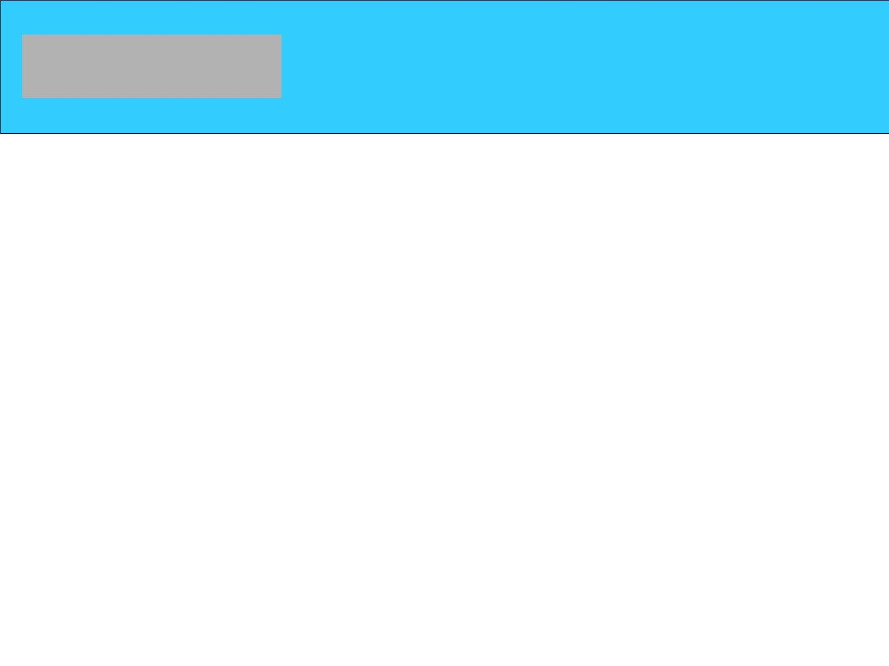
SEGMENT
Before discussing TCP in more detail, let us discuss the TCP packets
themselves. A packet in TCP is called a segment.
MSS: Maximum Segment size
•The MSS value counts only data octets
•The maximum segment size to avoid fragmentation is equal to the largest
datagram size that any host is required to be able to reassemble minus the IP
header size and TCP header sizes.
IPv4 hosts are required to be able to handle an MSS of 536 octets (= 576- 20 - 20)
IPv6 hosts are required to be able to handle an MSS of 1220 octets (= 1280 - 40 -
20).

Slide 42
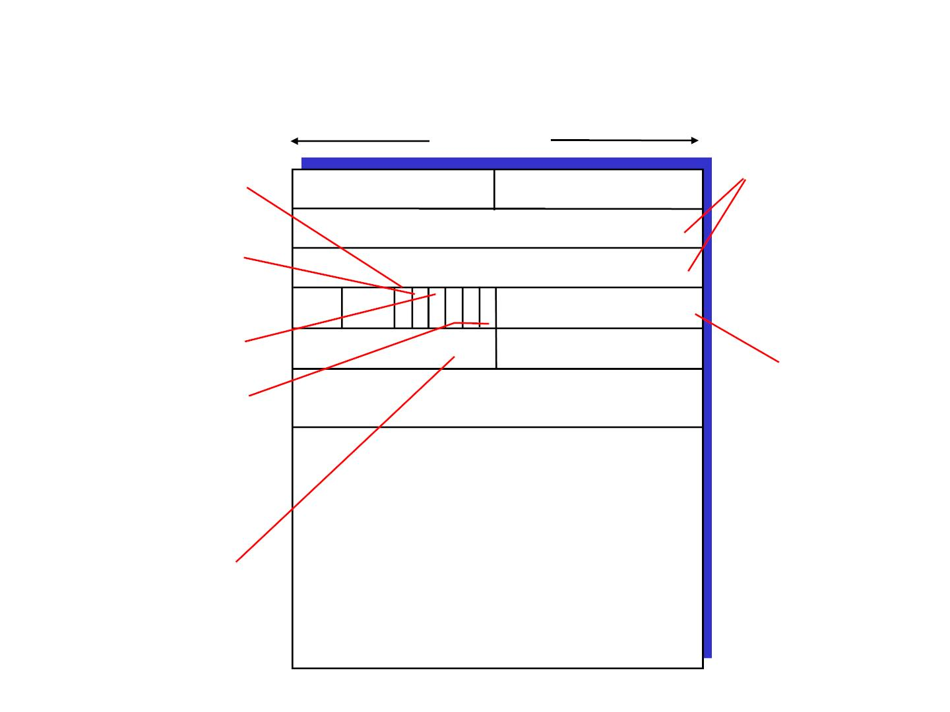
TCP segment structure
32 bits
URG: urgent data
counting
by bytes
(generally not used)
source port # dest port #
sequence number
of data
ACK: ACK #
valid
(not segments!)
acknowledgement number
PSH: push data now
(generally not used)
head not
len used
UAP RSF
Receive window
# bytes
rcvr willing
to accept
checksum
Urg data pnter
RST, SYN, FIN:
connection estab
(setup, teardown
commands)
Options (variable length)
application
data
(variable length)
Internet
checksum
(as in UDP)

Slide 43
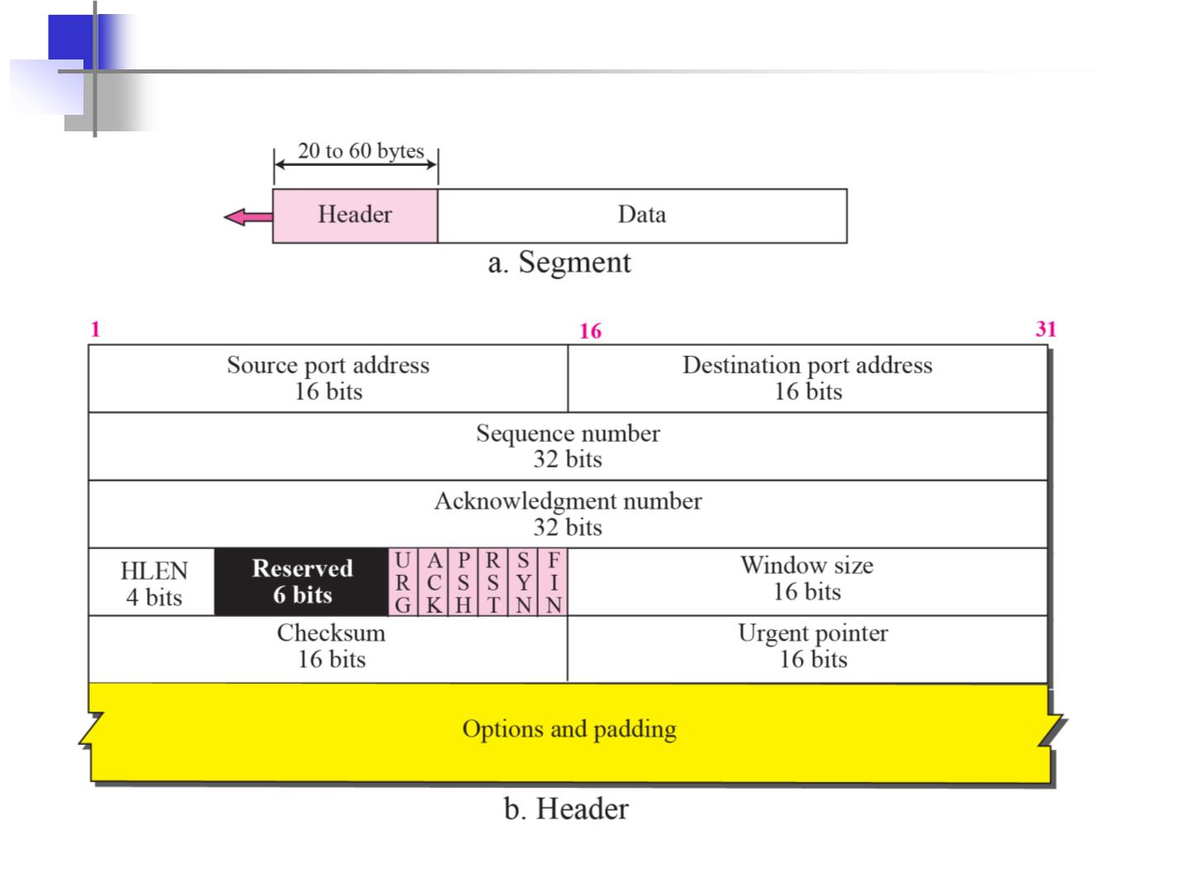
Figure 15.5 TCP segment format

Slide 44
Sequence Number:
❒ Sequence number is 32 bits long.
❒ So the range of SeqNo is
0 <= SeqNo <= 2³²-1 » 4.3 Gbyte
❒ Each sequence number identifies a byte in the byte stream.
❒ Initial Sequence Number (ISN) of a connection is set during
connection establishment
• If the SYN flag is set (1), then this is the initial sequence number. The
sequence number of the actual first data byte and the acknowledged
number
in the corresponding ACK are then this sequence number plus 1.
• If the SYN flag is clear (0), then this is the accumulated sequence
number of the first data byte of this segment for the current session.

Slide 45
Acknowledgement Number :
Acknowledgements are piggybacked, i.e. a segment from
A ->B can contain an acknowledgement for a data sent in the
B ->A direction
❒ A hosts uses the AckNo field to send acknowledgements. (If a
host sends an AckNo in a segment it sets the “ACK flag”)

Slide 46
Header Length ( 4bits):
❒ Length of header in 32-bit words
❒ It indicates the number of 4-byte words.
❒ The minimum size header is 5 words and the maximum is 15 words
thus giving the minimum size of 20 bytes and maximum of 60 bytes
❒ Q. Why minimum is 20 and maximum is 60.?
❒ Reserve bits are stored for future use.
Note that TCP header has variable length (with minimum 20 bytes and
maximum 60 bytes.)

Slide 47
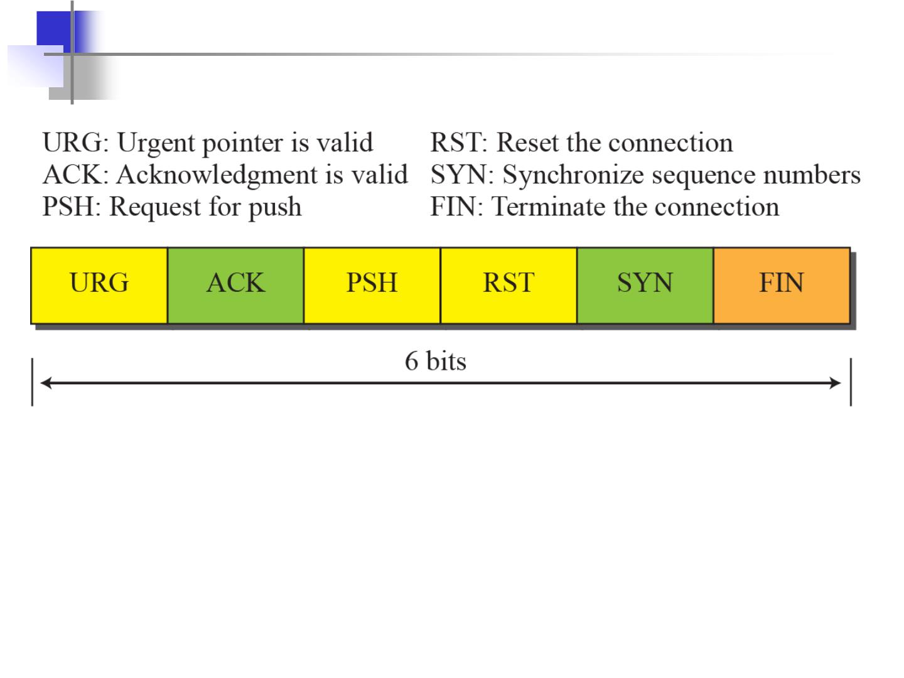
Control field

Slide 48
Window Size:
❒ Each side of the connection advertises the window size
❒ Window size (the size of the receive window)is the maximum number of
bytes that a receiver can accept.
❒ Maximum window size is = 65535 bytes
TCP windows
The throughput of a communication is limited by two windows:
1. congestion window (for congestion control)
2. receive window (for flow control)
Each TCP segment contains the current value of the receive window.
For example a sender receives an ack which acknowledges byte 4000 and
specifies a receive window of 10000 (bytes), the sender will not send packets
after byte 14000, even if the congestion window allows it.

Slide 49
TCP Checksum:
❒ TCP checksum covers over both TCP header and
TCP data (also covers some parts of the IP header)
Urgent Pointer:
🞂 Only valid if URG flag is set
🞂 Used when segment contains some urgent data.
Options:
🞂 Additional information in header.

Slide 50
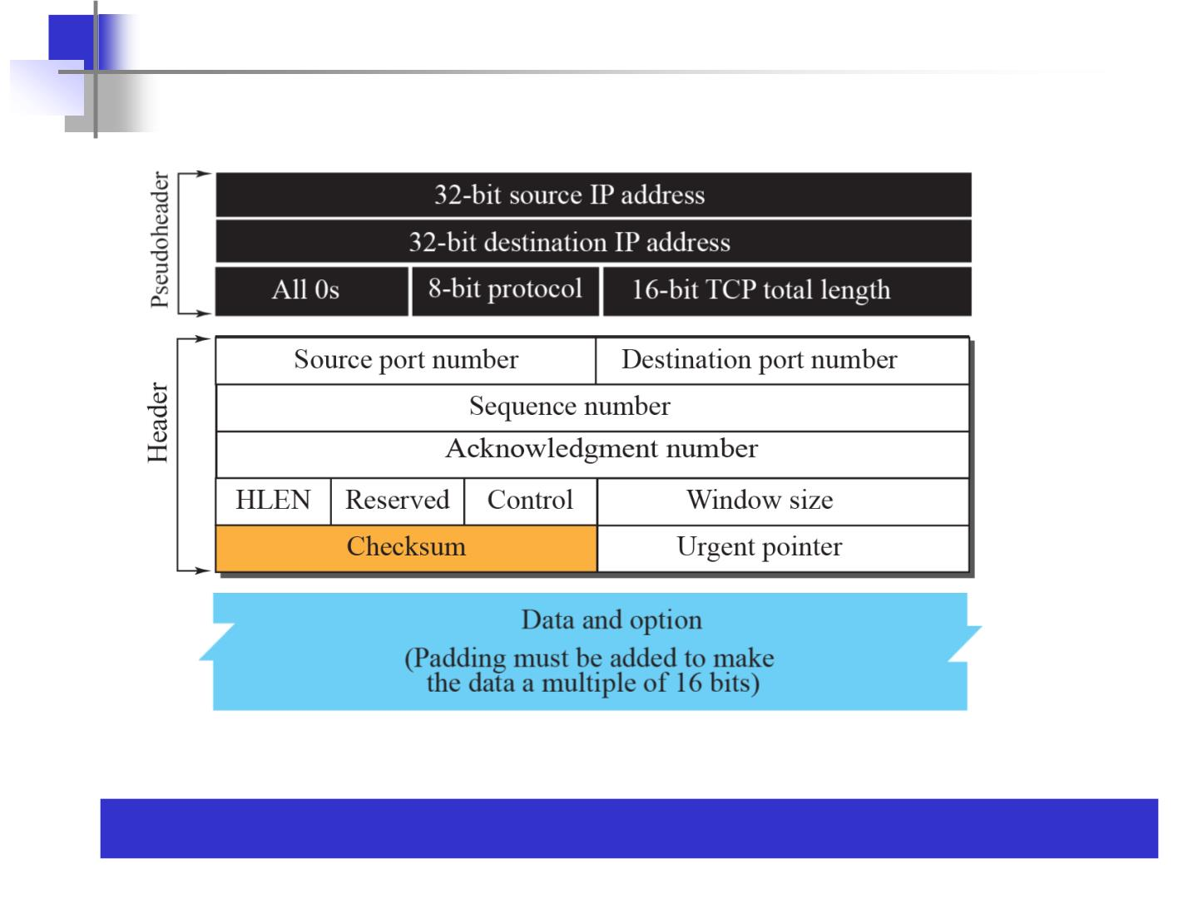
Pseudoheader added to the TCP segment
Note: The use of the checksum in TCP is mandatory.

Slide 51
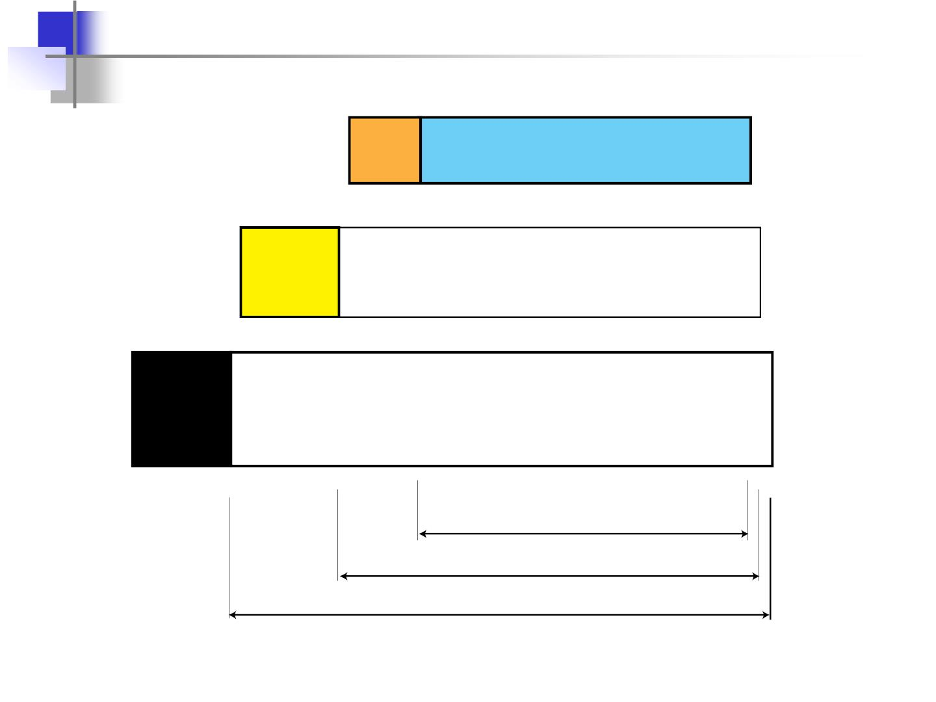
Encapsulation
TCP
header
Application-layer data
IP
header
Frame
header
TCP payload
IP payload
Data-link layer payload

Slide 52
Question:. The following is a dump of a TCP header in hexadecimal
format.
05320017 00000001 00000000 500207FF 00000000
a. What is the source port number?
b. What is the destination port number?
c. What the sequence number?
d. What is the acknowledgment number?
e. What is the length of the header?
f. What is the type of the segment?
g. What is the window size?

Slide 53
a.1330
b. 23
c. 1
d. 0
e. 5===5*4=20 bytes
f. 2===SYN
g. 2047

Slide 54
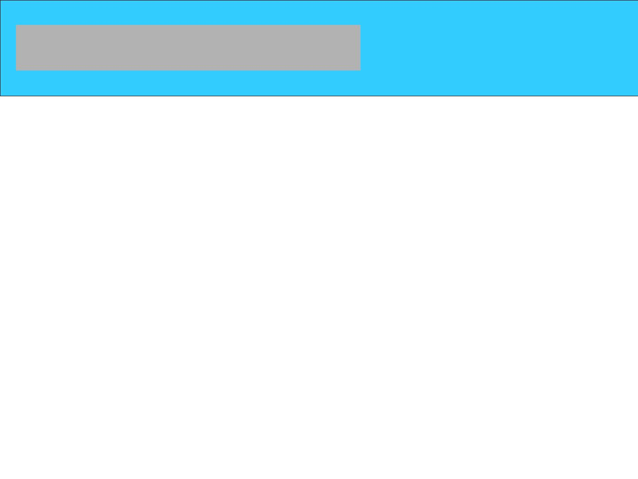
A TCP CONNECTION
TCP is connection-oriented. It establishes a virtual path between the source and destination. All of the
segments belonging to a message are then sent over this virtual path. You may wonder how TCP, which
uses the services of IP, a connectionless protocol, can be connection-oriented. The point is that a TCP
connection is virtual, not physical. TCP operates at a higher level. TCP uses the services of IP to deliver
individual segments to the receiver, but it controls the connection itself. If a segment is lost or corrupted, it is retransmitted.

Slide 55
Window Size
The Window size is considered to be one of the most important flags within the TCP header. This field is used by the receiver to indicate to the sender the amount of data that it is able to accept. The Window size field is the key to efficient data transfers and flow control. Used in bytes.
55

Slide 56
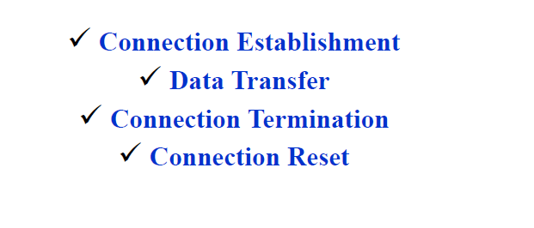
56

Slide 57
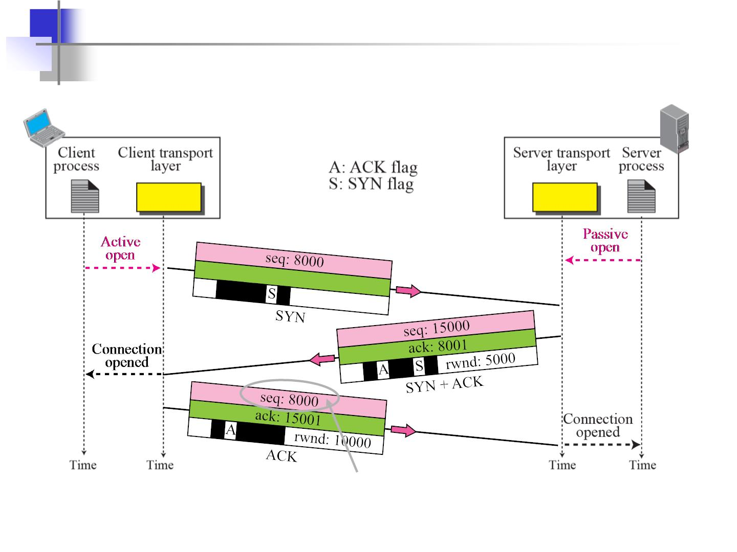
Connection establishment using three-way handshake
Means “no data” !
seq: 8001 if piggybacking

Slide 58
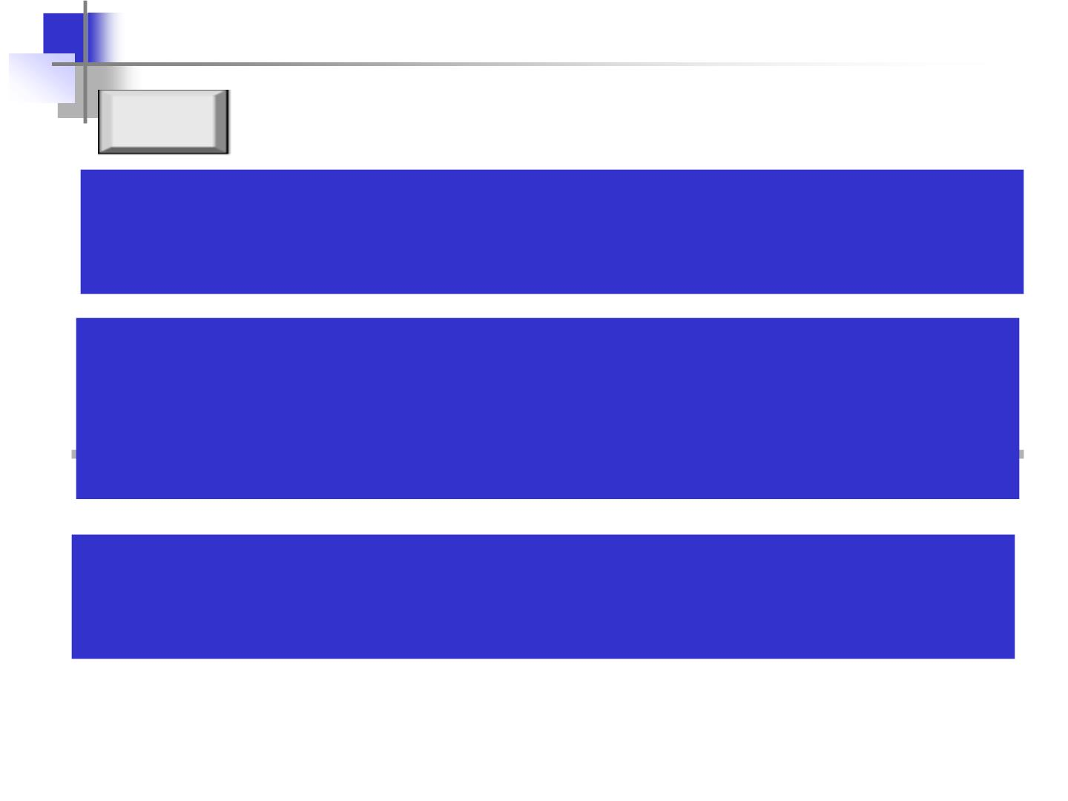
Note
A SYN segment cannot carry data, but
it consumes one sequence number.
A SYN + ACK segment cannot carry data, but does consume one sequence number.
An ACK segment, if carrying no data,
consumes no sequence number.

Slide 59
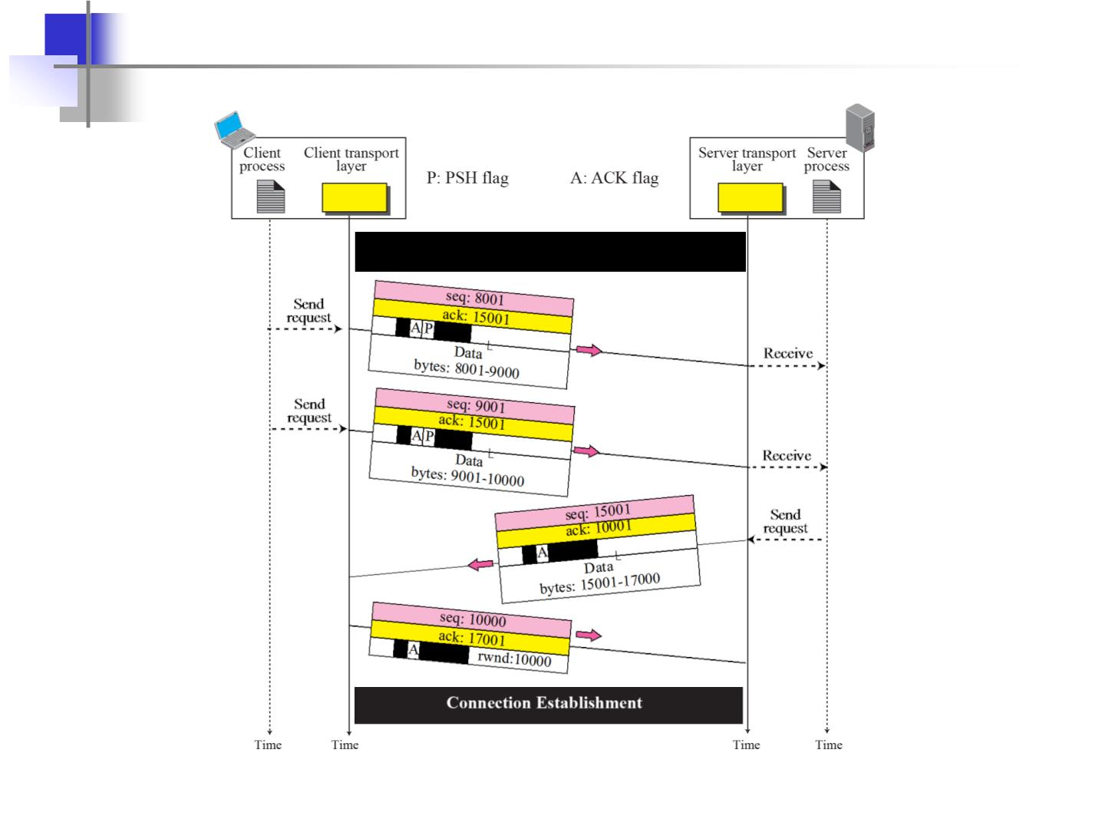
Data Transfer
Connection Termination

Slide 60
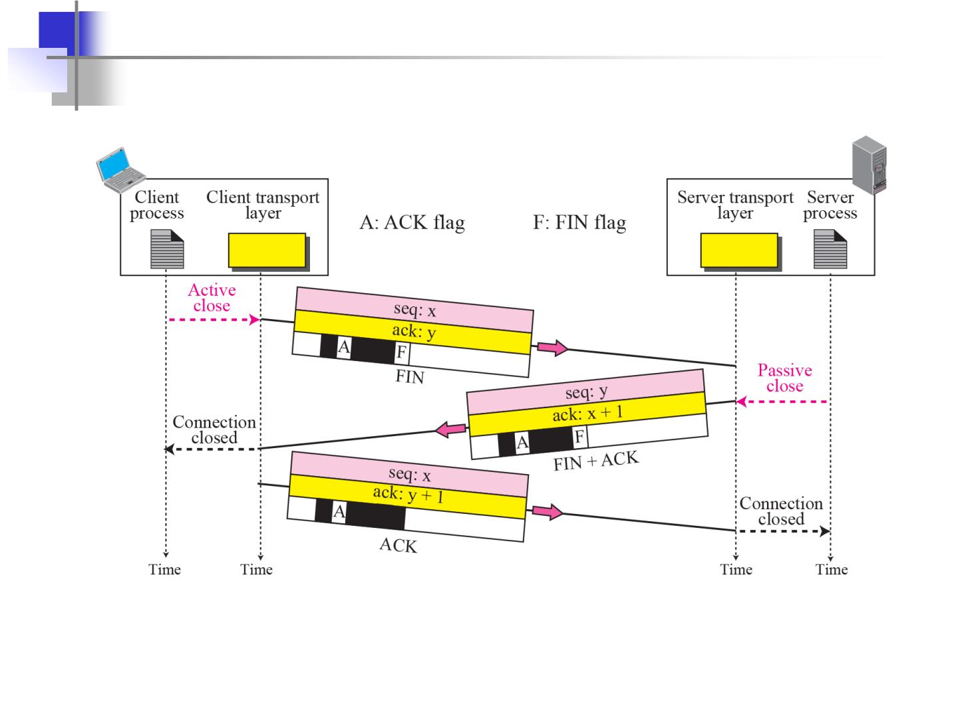
Connection termination using three-way handshake

Slide 61
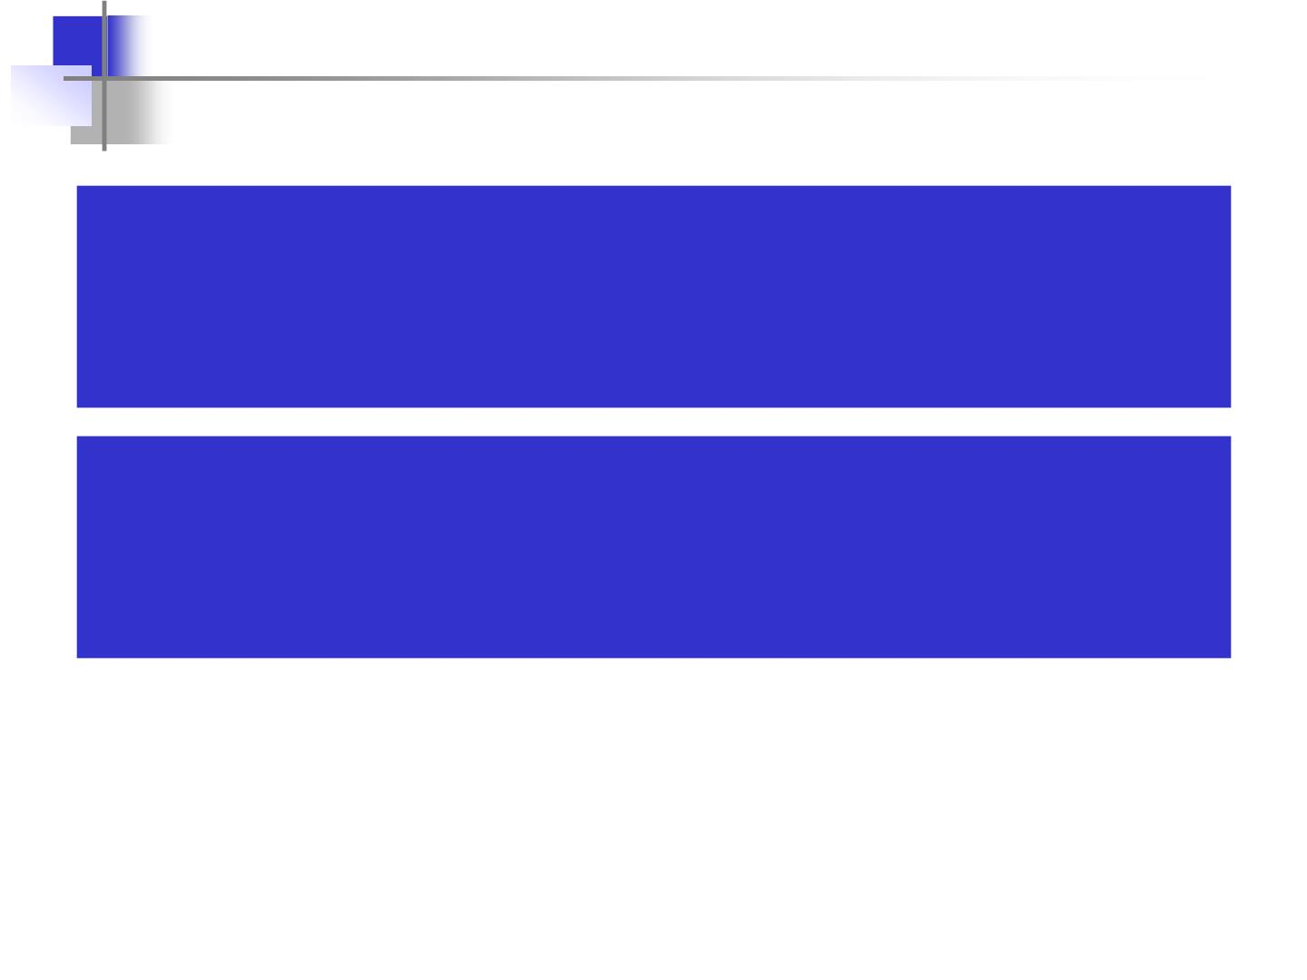
The FIN segment consumes one
sequence number if it does
not carry data.
The FIN + ACK segment consumes one
sequence number if it does
not carry data.

Slide 62
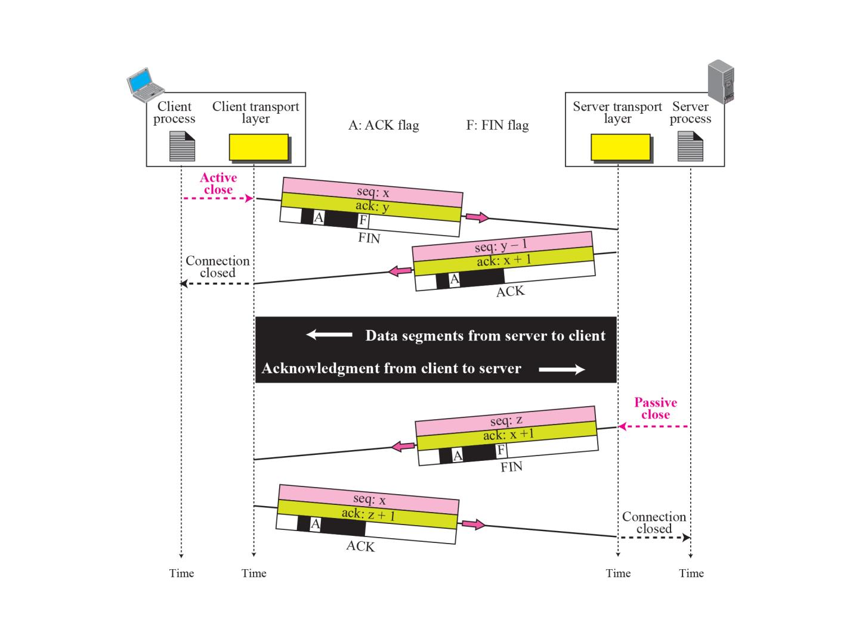
Half-Close

Slide 63
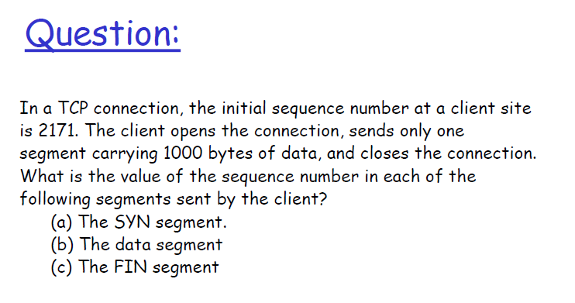
63

Slide 64
Solution
(a) 2171
(b) 2172
(c) 3172

Slide 65
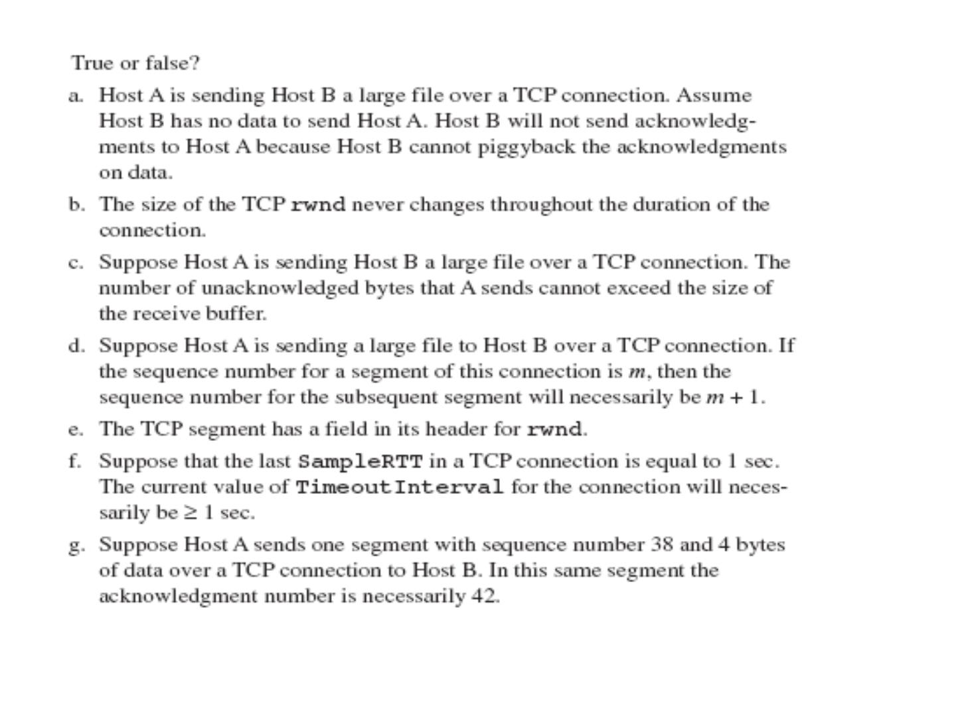
Notes:
http://web.eecs.utk.edu/~hqi/teaching/ece453f06/hw/hw7_sol.htm
65

Slide 66

Question:
TCP opens a connection using initial sequence number (ISN) of 14,534. The
other party opens the connection with an ISN 21732. Show the three TCP
segments during the connection establishment.

Slide 67
Flow Control
69

Slide 68
Flow Control
❒ Flow Control
❒ Sender variables
❒ Receiver variables
❒ Sliding Window
❒ Sliding Window Protocols
70

Slide 69

69

Slide 70

70

Slide 71
Sender Variables
❒ Each segement is assigned a sequence
number - SeqNum
❒ The sender maintains three variables: send
window size (SWS),
last ACK received (LAR),
and last Frame sent (LFS)
73

Slide 72
Sender Variables
❒ SWS:: the upper bound on the number of
outstanding frames (not ACKed) the sender
can transmit.
❒ LAR :: the sequence number of the last
ACK received.
❒ LFS :: the sequence number of the last
frame sent.
74

Slide 73

73

Slide 74

74

Slide 75

75

Slide 76
Flow Control Mechanisms
1. One possibility is send 1 data and wait for ack.
2. Or send all the data without worrying about ack’s. For this
reason window concept came.
❒ Stop and Wait
❒ Go back N
❒ Selective Repeat
76

Slide 77

77

Slide 78

78

Slide 79

1. stop-and-wait operation
sender
first packet bit transmitted, t = 0
last packet bit transmitted, t = L / R
receiver
first packet bit arrives
D
last packet bit arrives, send ACK
ACK arrives, send next
packet, t = D + L / R
77

Slide 80

80

Slide 81

81

Slide 82

stop-and-wait : Normal Operation

Slide 83
❒ stop-and-wait : Damaged Frame
❒ stop-and-wait : Lost Frame
❒ stop-and-wait : Lost ACK and NAK

Slide 84

Window size
84

Slide 85
Example
L=8000bits per packet
Bandwidth=1GBPS
RTT=15ms
Time to enter last bit into channel=L/R=8ms
Last bit coming to receiver side=RTT/2+L/R
Last ack emerges back to sender=RTT+L/R
Find efficiency of sender
85

Slide 86


86

Slide 87

87

Slide 88

Pipelining: increased utilization
sender
receiver
first packet bit transmitted, t = 0
last bit transmitted, t = L / R
first packet bit arrives
D
last packet bit arrives, send ACK
last bit of 2nd packet arrives, send ACK
last bit of 3rd packet arrives, send ACK
ACK arrives, send next
packet, t = D + L / R
Increase utilization
by a factor of 3!
U
3 * L / R
D + L / R
24ms
_{sender}=
=
0.24
=
100ms
82

Slide 89

Window size
89

Slide 90

90

Slide 91

91

Slide 92

92

Slide 93
3. Selective Repeat
❒ In Selective Repeat, only the specific damaged or lost
frame is retransmitted.
❒ Receiving device must contain sorting logic to enable it to
reorder frames received out of sequence.
❒ Sending device must contain a searching mechanism that
allows it to find and select only requested frame for
retransmission.
102

Slide 94

Selective reject, damaged data frame
103

Slide 95
In Go-back-N ARQ, the size of the sender window must be less
than , where m is the number of bits used for the
2^{m}
Representation of sequence numbers. why the size of the
sender window must be less than 2^{m}
104

Slide 96

96

Slide 97

97

Slide 98

98

Slide 99

99

Slide 100
Sliding Window?
❒ Window spans a portion of buffer containing bytes received
from the process.
❒ The bytes inside the window are that can be in transit, they
can be sent without worrying about ack.
❒ Windows has two walls: left and right. Congestion Window (cwnd) is a TCP state variable that limits the amount of data the TCPCongestion Window (cwnd) is a TCP state variable that limits the amount of data the TCP can send into the network before receiving an ACK. The Receiver Window (rwnd) is a variable that advertises the amount of data that the destination side can receive. Together, the two variables are used to regulate data flow in TCP connections, minimize congestion, and improve network performance. Windows can be: opened, closed and shrunk. Size of the window = min [rwnd, cwnd]
❒ Sliding window uses identification scheme based on size of window for keeping the track of transmitted and received segments. i.e. for modulus n 0 to n-1
83

Slide 101
Questions:
What is the value of the receiver window (rwnd) for host A if the
receiver, host B, has a buffer size of 5,000 bytes and 1,000 bytes
of received and unprocessed data?
Solution
The value of rwnd = 5,000 − 1,000 = 4,000. Host B can receive
only 4,000 bytes of data before overflowing its buffer. Host B
advertises this value in its next segment to A.
84

Slide 102
What is the size of the window for host A if the value of rwnd is
3,000 bytes and the value of cwnd is 3,500 bytes?
Solution
The size of the window is the smaller of rwnd and cwnd, which is
3,000 bytes.
85

Slide 103

Figure below shows an unrealistic example of a sliding window.
The sender has sent bytes up to 202. We assume that cwnd is 20
(in reality this value is thousands of bytes). The receiver has sent
an acknowledgment number of 200 with an rwnd of 9 bytes (in
reality this value is thousands of bytes). The size of the sender
window is the minimum of rwnd and cwnd or 9 bytes. Bytes 200
to 202 are sent, but not acknowledged. Bytes 203 to 208 can be
sent without worrying about acknowledgment. Bytes 209 and
above cannot be sent.
86

Slide 104

In previous Figure the server receives a packet with an
acknowledgment value of 202 and an rwnd of 9. The host has
already sent bytes 203, 204, and 205. The value of cwnd is still
20. Show the new window.
Solution:
87

Slide 105

Now In previous Figure the sender receives a packet with an
acknowledgment value of 206 and an rwnd of 12. The host has
not sent any new bytes. The value of cwnd is still 20. Show the
new window.
Solution
The value of rwnd is less than cwnd, so the size of the window is
12. Figure below shows the new window. Note that the window
has been opened from the right by 7 and closed from the left by
4; the size of the window has increased.
88

Slide 106

In previous Figure the host receives a packet with an
acknowledgment value of 210 and an rwnd of 5. The host has
sent bytes 206, 207, 208, and 209. The value of cwnd is still 20.
Show the new window.
Solution
The value of rwnd is less than cwnd, so the size of the window is
5. Figure below shows the situation. Note that this is a case not
allowed by most implementations. Although the sender has not
sent bytes 215 to 217, the receiver does not know this.
89

Slide 107
How can the receiver avoid shrinking the window in the previous
example?
Solution
The receiver needs to keep track of the last acknowledgment
number and the last rwnd. If we add the acknowledgment
number to rwnd we get the byte number following the right wall.
If we want to prevent the right wall from moving to the left
(shrinking), we must always have the following relationship.
new ack + new rwnd ≥ last ack + last rwnd
or
new rwnd ≥ (last ack + last rwnd) − new ack
90

Slide 108

Note:
To avoid shrinking the sender window,
the receiver must wait until more space
is available in its buffer.
91

Slide 109

Note:
Some points about TCP’s sliding windows:
❏ The size of the window is the lesser of rwnd and cwnd.
❏ The source does not have to send a full window’s
worth of data.
❏ The window can be opened or closed by the receiver,
but should not be shrunk.
❏ The destination can send an acknowledgment at any
time as long as it does not result in a shrinking window.
❏ The receiver can temporarily shut down the window;
the sender, however, can always send a segment of one
byte after the window is shut down.
92

Slide 110
❑ Window shutdown
❑ Probing (to prevent deadlock)
❑ Silly Window syndrome
❑ Nagle’s Algorithm
❑ Clark’s solution
93

Slide 111

111

Slide 112

112

Slide 113
❒ If the application program is faster than the network the
segments are larger(maximum size segment).
❒ If the application program is slower than the network the
segments are smaller(less than the maximum size segment
size).
96

Slide 114

114

Slide 115
2. Go-Back-N
❒ In Go-Back-N if one frame is lost or damaged all frames
sent since the last frame acknowledged are retransmitted.
❒ Sending device keeps copies of all transmitted frames until
they have been acknowledged.
❒ Sending device is equipped with the timer.
❒ Both ACK and NAK must be numbered for identification.
❒ On timeout, send all packets previously sent but not yet
ACKed.
❒ Uses a single timer – represents the oldest transmitted, but
not yet ACKed pkt
❒ NAK does not indicate whether the frame has been lost or
damaged, just that it needs to be resent.
98

Slide 116

Go-Back-n, damaged data frame
99

Slide 117

Go-Back-n,lost data frame
100

Slide 118

Go-Back-n, (lost ACK, lost NAK)
101

Slide 119
Questions:
108

Slide 120
1. In stop-and-wait system, bandwidth of the line is 1 Mbps
and 1 bit takes 20 ms to make a round trip. What is the
bandwidth-delay product? If the system data frames are
1000bits in length what is the utilization percentage of the
link?
2. What is the Utilization percentage of the link if the link uses
go-back-n with a 15 frame sequence?
112

Slide 121
3. Consider transferring an enormous file of L bytes from Host A to
Host B.
a) What is the maximum value of L such that TCP sequence numbers
are not exhausted? Recall that the TCP sequence number field has
4 bytes.
b) Assume an MSS of 1460 bytes. For the L you obtain in (a), find
how long it takes to transmit the file. Assume that a total of 66
bytes of transport, network, and data-link header are added to each
segment before the resulting packet is sent out over a 10 Mbps
link. Ignore flow control and congestion control so A can pump
out the segments back to back and continuously.
Note: MSS is the maximum size of user data carried by any segment
in a TCP connection. In SYN segment, using TCP options header,
each TCP entity informs to the other about which MSS wants to use.
The smaller will be used.

Slide 122

115

Slide 123
4. A system uses the Stop-and-Wait ARQ Protocol. If each
packet carries 1000 bits of data, how long does it take to send
1 million bits of data if the distance between the sender and
receiver is 5000 Km and the propagation speed is 2 x 108 m/s?
Ignore waiting, and processing delays. We assume
no data or control frame is lost or damaged.
16. Repeat above Exercise using the Go-back-N ARQ Protocol
with window size of 7. Ignore the overhead due to the header
and trailer.
17. Repeat above using the Selective-Repeat ARQ Protocol
with a window size of 4. Ignore the overhead due to the header
and the trailer.
117

Slide 124

118

